Slide 1
Comp Data Security & Privacy Project

Slide 2
01
HYDRA
02
NMAP
03
NIKTO
CONTENTS:

Slide 3
HYDRA
Hydra is a parallel login cracker tool that supports multiple attack protocols. It is very fast and flexible, and new modules can be easily added.
Using this tool, researchers and security consultants can demonstrate how easy it is to gain unauthorized access to systems remotely. Hydra is a brute force tool that helps penetration testers and ethical hackers crack passwords to web services. Hydra can perform quick dictionary attacks against more than 50 protocols. In a dictionary attack, we have one/multiple usernames and provide Hydra with a dictionary of passwords. Hydra then tests all of these passwords against each user in the list.

Slide 4
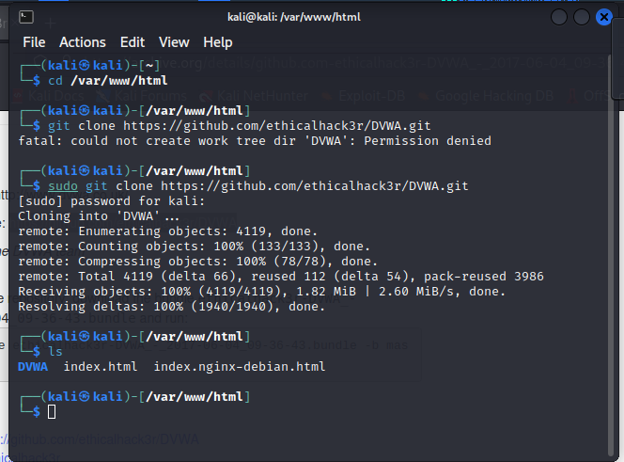
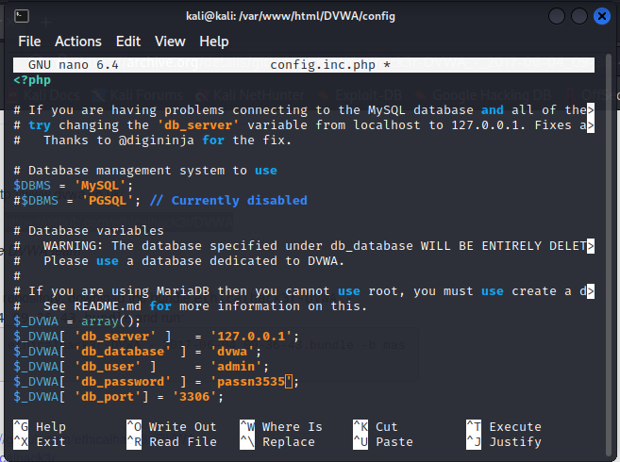
2.1 Hydra Used procedure
Step 2: Save DVWA database configuration

Slide 5
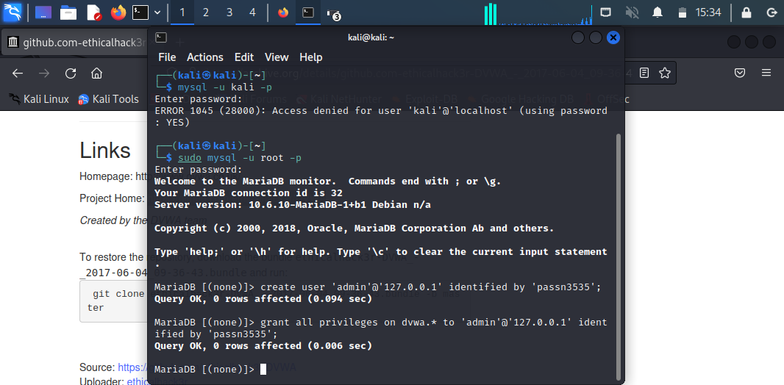
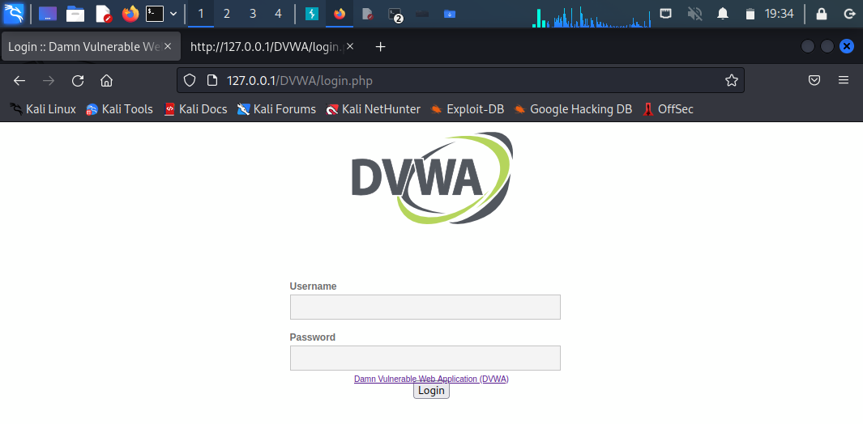
Step 3: Activate the DVWA database using the configuration information
Step 4: Successfully launching the site login page in kali using the machine IP address

Slide 6
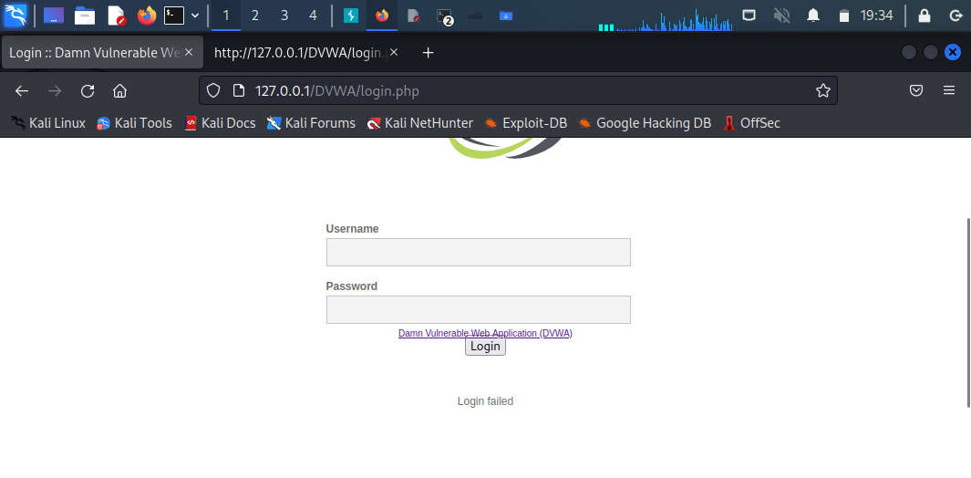
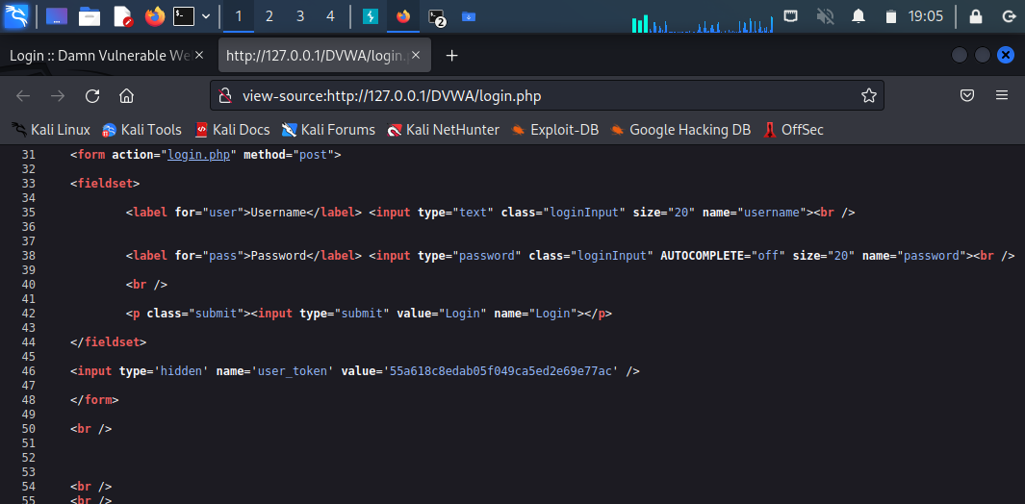
Step 5: Trying to log in with a random username and password
Step 6: Opening the source page view for the login webpage which provides more information about the form. We can see the fields names of the inputs “username”,”password”, and “Login”

Slide 7
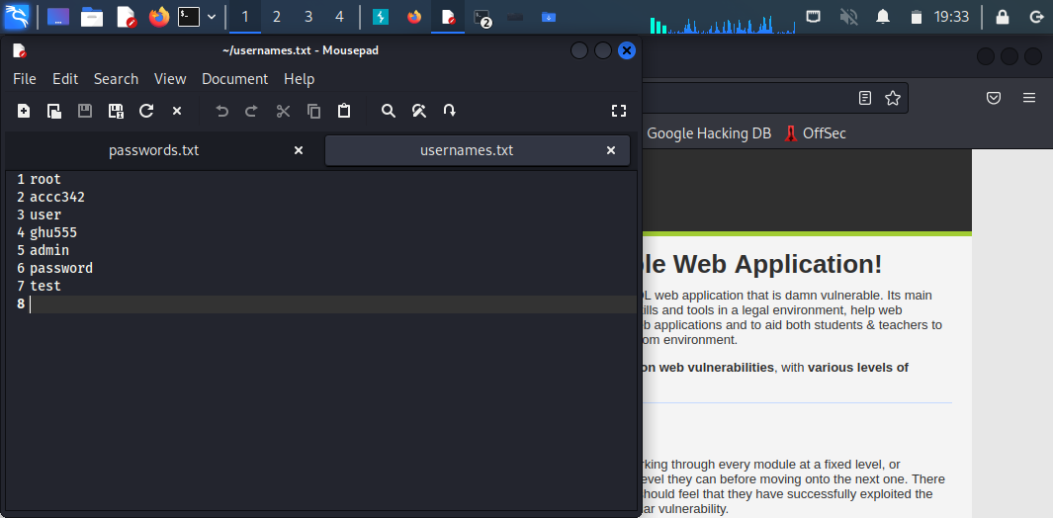
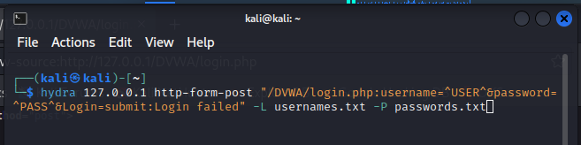
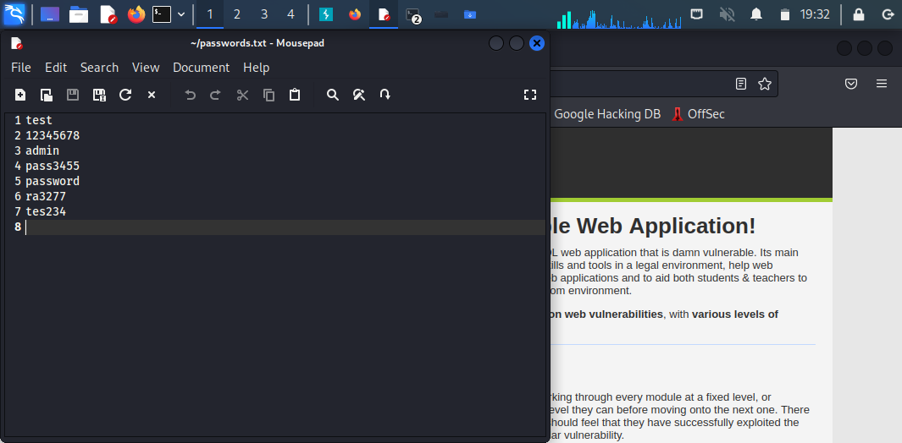
Step 7: Create a file containing usernames and a file containing passwords
Step 8: Writing the hydra command using these parameters: § The IP address § URL path § The failure message § Usernames list § Password list

Slide 8
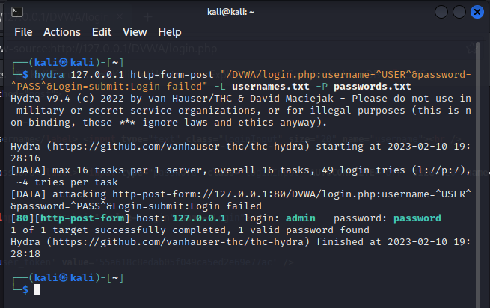
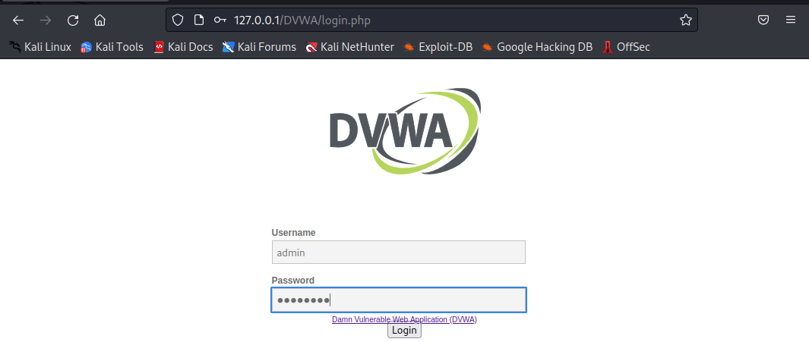
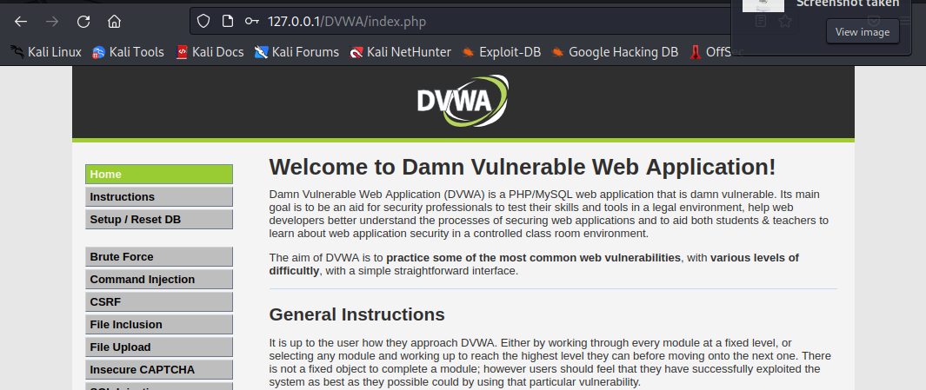
Step 9: The output of hydra with the valid username and password
Step 10: Successful login to the website using the username and password

Slide 9
NMAP
Nmap is one of the tools used for information gathering, as it is free and open source. By using Nmap, you can determine which hosts are on your network, see what kind of firewalls are in place, find and exploit vulnerabilities, and identify operating systems. It is designed to scan large networks but also works with single hosts. Furthermore, Nmap comes with Zenmap, which is the same tool as Nmap, but uses a GUI instead of a command line.

Slide 10
NMAP
Common commands in Nmap :
Goal | Command | Example
Scan a Single Target | nmap [target] | nmap 10.0.2.15
OS Detection | nmap -O [target] | nmap -O 10.0.2.15
Open Ports | nmap –open [target] | nmap –open 10.0.2.15
Help | nmap -h | nmap -h
Nmap Version | nmap -V | nmap -V

Slide 11
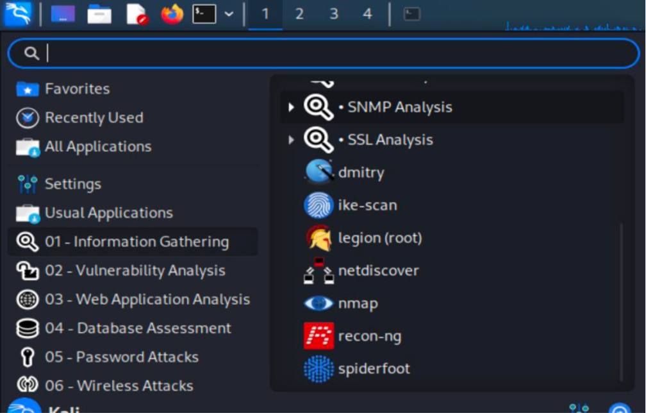
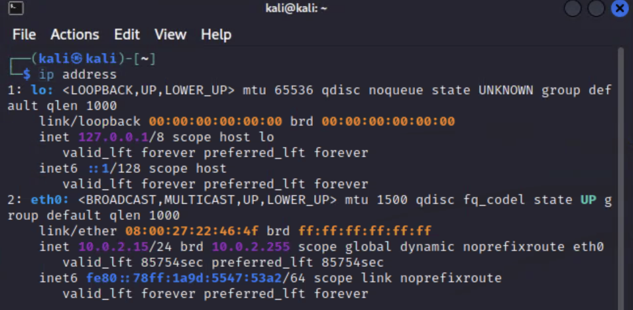
Step 1:
Step 2:

Slide 12
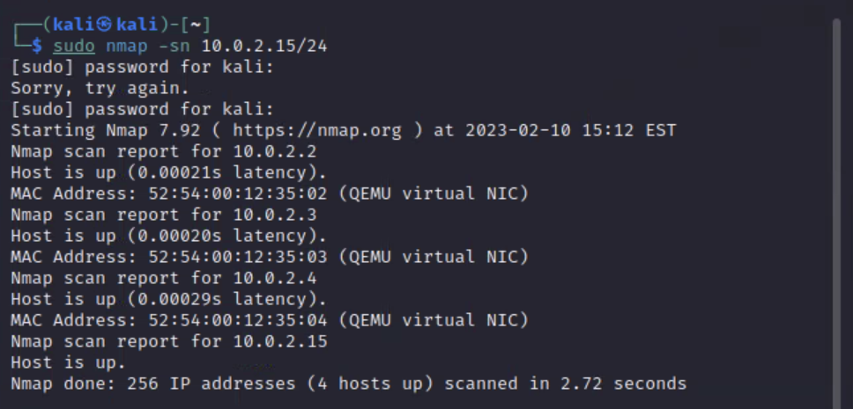
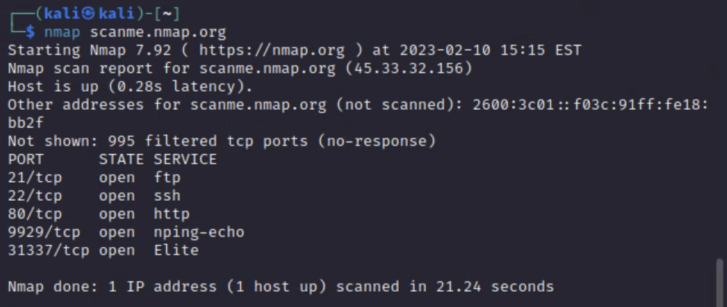
Step 3
Step 4

Slide 13
NIKTO
SECURITY
COMPANY
Nikto is a free and open source, the nikto tool is written in Perl and has a GNU license. Chris Sullo programmed it to scan web servers. Since this tool scans more than 6,700 files for potential security vulnerabilities, it is very effective at scanning websites. Nikto has only one drawback that website security measures are more likely to detect the tool because it is not obvious. The default installation is available on the Kali Linux penetration testing system, It can also be run directly from the terminal as shown below[8]

Slide 14
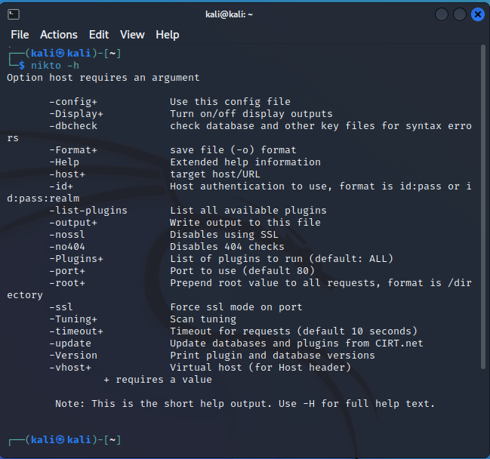
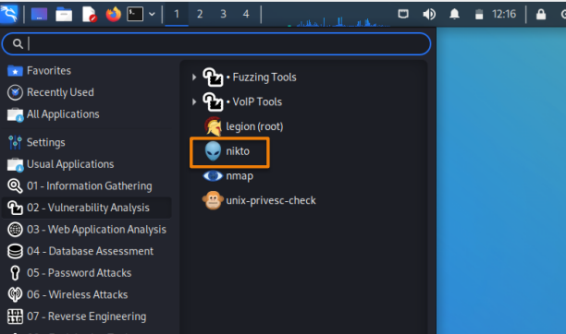
Step 1:
Step 2:

Slide 15
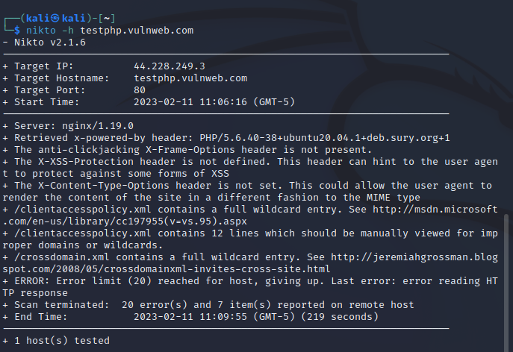
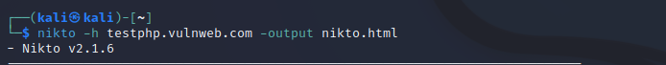
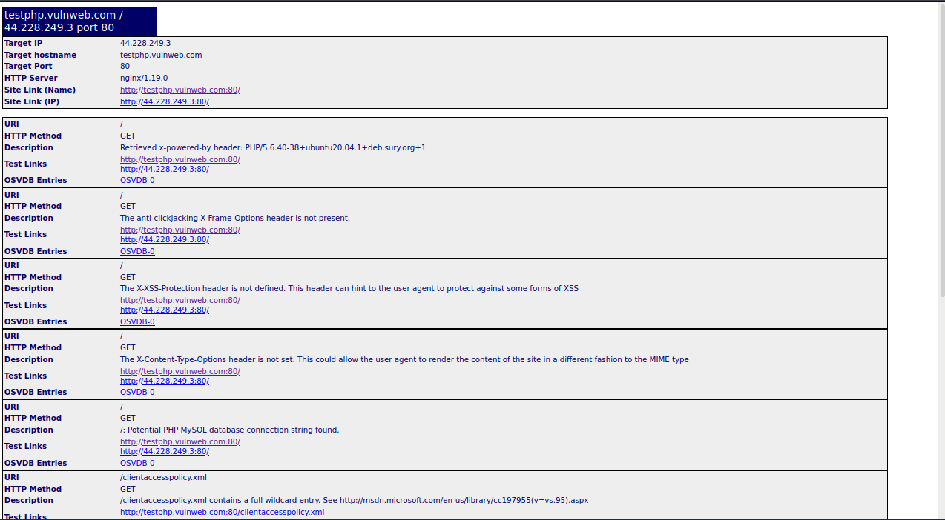
Step 3:
Step 4:

Slide 16
GROUP MEMBERS
Dana Kurdi 2200005678
Bushra Alshehri 2200004242
Albandari Alsanhani 2200006257
Jumana Aljassim 2200006269

Slide 17
THANK YOU
GROUP 2

